Slide 1




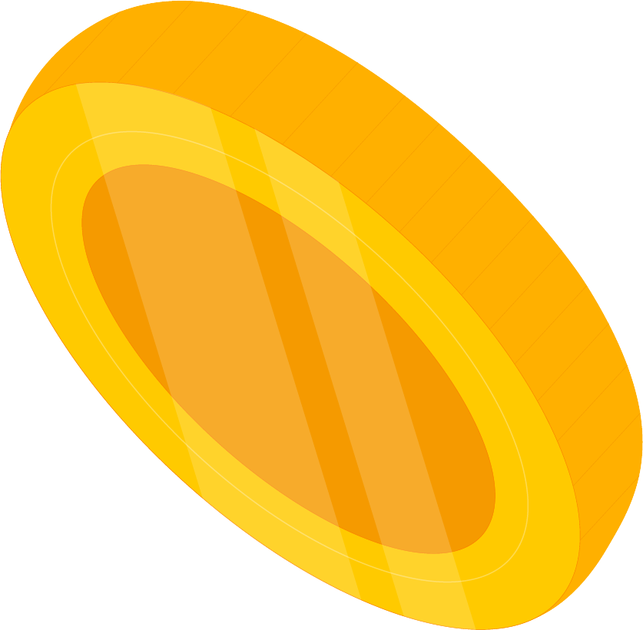





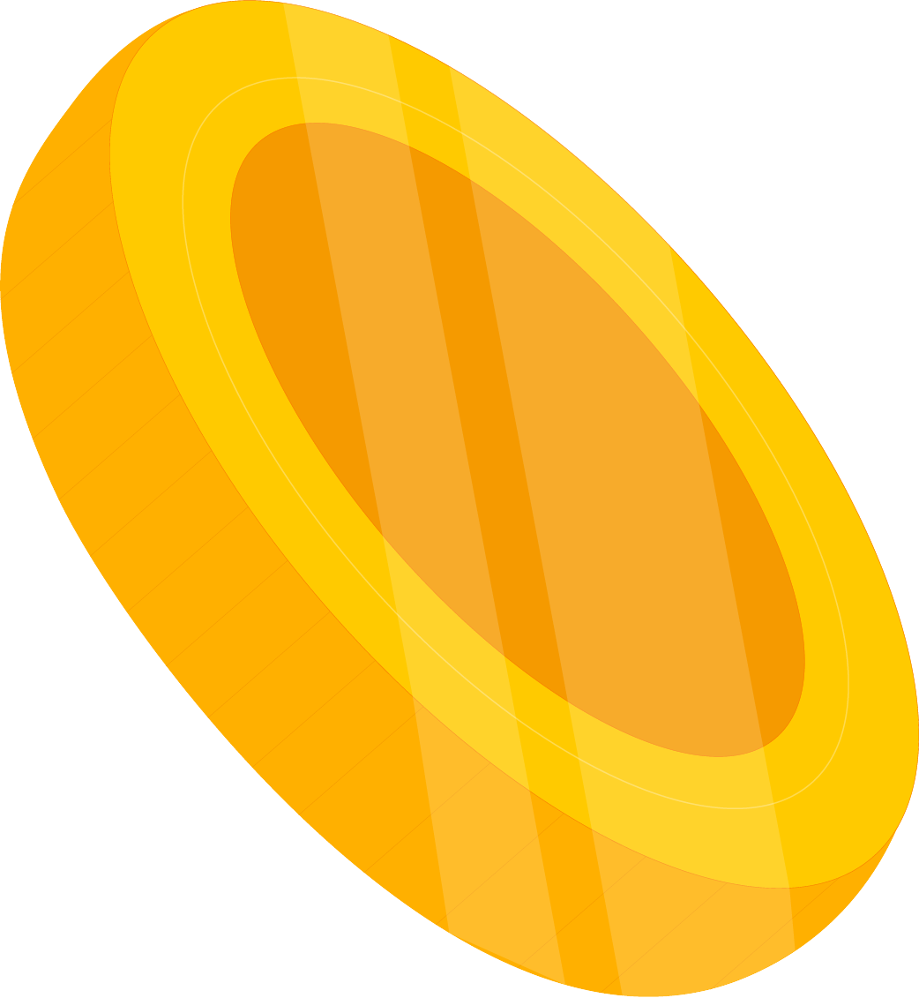

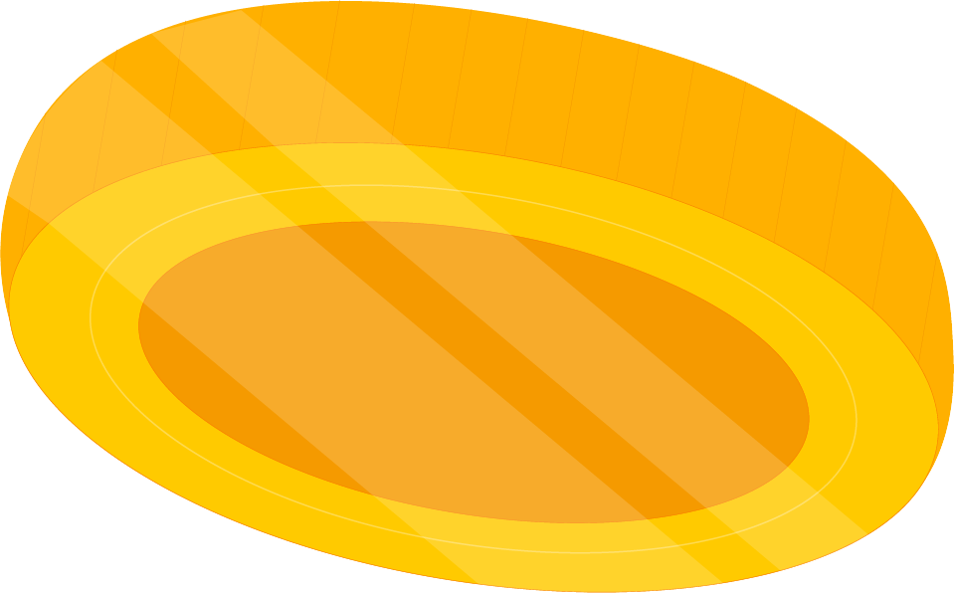
ETF ANALYZER
PROJECT
Collaborators:
Adam Cooke Ros Tiamzon
Nevyn Brown Priya Sukumaran

Slide 2
TABLE OF CONTENTS
01
Executive Summary
02
Data Collection, Cleanup & Exploration
03
Results (Demo)
04
Achieving Project Goals
05
Next steps ……

Slide 3



Executive Summary
The aim of our project is to provide investors advice on which Exchange Traded Fund (ETF) is best to invest in (best returns) based on their risk appetite, type of ETF they prefer and time period they want to keep their money invested in.
In this project, we applied financial analysis concepts to be able to give sound advice to investors. In coming up with financial advice we used financial programming concepts and skills to calculate ETFs’ performance using historical data and forecasting future performance.

Slide 4


Executive Summary
ETFs selected for analysis (Diversified Strategies):
BND - Vanguard Bond ETF
VNQ - Vanguard Real Estate Index Fund
VOX - Vanguard Communication Services Index Fund
VIG - Vanguard Dividend Appreciation Index Fund
SNP - S&P 500 Index Fund
How this project works ….
We created an investor interface (CLI) where users can ask for which ETF is best to invest in based on:
Risk appetite (no/little risk, medium risk or high risk)
Type of ETF (Mutual Fund, Fixed Income Fund, Real Estate, Specialty/Sector, Dividend-Focused)
Time / Investment Period (2, 5 or +10 years)
Investor interface will recommend ETF to invest in based on responses
Financial analysis and programming codes were used to come up with financial advice

Slide 5

Executive Summary
Finance terms used:
Daily returns: The change in price as a % of the previous day’s price.
Cumulative returns: The total change in price over a set time.
Standard deviation: The measure of variance from the mean.
High STD: more volatile / risky
Low STD: stable / safer
Annual average returns: The money made or lost over a set period.
Covariance: The variability of two different things.
Correlation: How two things move in relation to each other.
Sharpe ratios: Comparison of the returns with the risks. The sharpe ratio gives a good starting point on whether an investment style gives a return that justify the risk taken on. Typically, the higher the sharpe ratio, the more attractive the return and the better the investment.

Slide 6


Data Collection, Cleanup & Exploration
Data Collection
Exploration
Cleanup
Data source is yfinance
<pip install yfinance>
yfinance provides market data of publicly traded securities
yfinance library: market information for a particular security / ticker
History module: provides market data for a given period for a particular security
Pulled market information for ETFs we are analyzing
Used .loc function for each ETF to pull specific data we need (i.e. closing prices)
Used concat in pandas to combine data of all 5 ETFs in 1 dataframe
Used Drop function to create a dataframe w/o the SNP

Slide 7
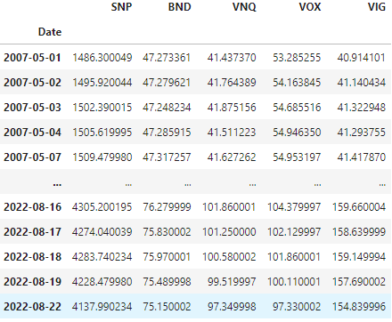
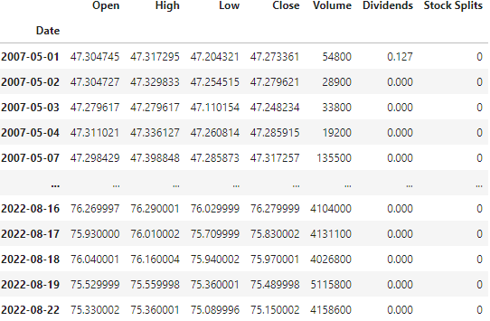
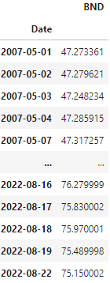
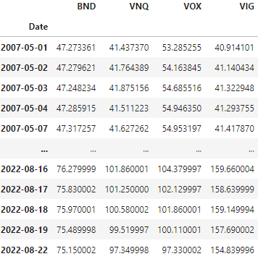
Data Collection, Cleanup & Exploration
Cleanup
Data Collection
Exploration

Slide 8

Results: Demonstration - > User Interface (CLI)

Slide 9








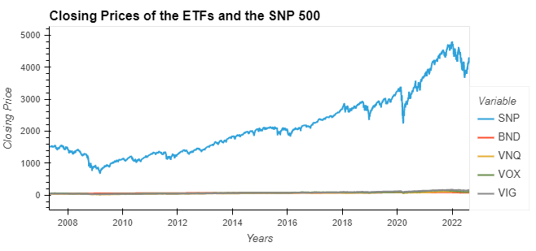
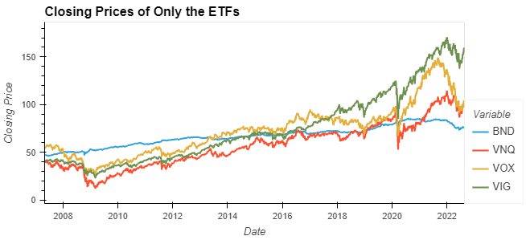
Approach in Achieving Project Goals
Plan
Allocate
Meet / Collaborate
Execute
Adjust
Finalize
Tools, libraries, dependencies used: PANDAS, YFINANCE, NUMPY, HVPLOT, SEABORN, MONTE CARLO, MCFORECASTTOOLS
Financial Analysis Codes:
We used the '.line' module from hvplot library to create a line plot to visualize the closing prices of the funds.

Slide 10
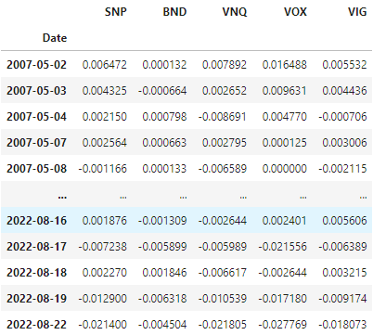
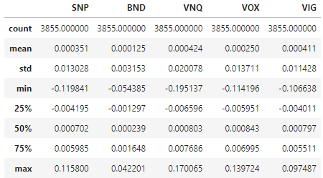
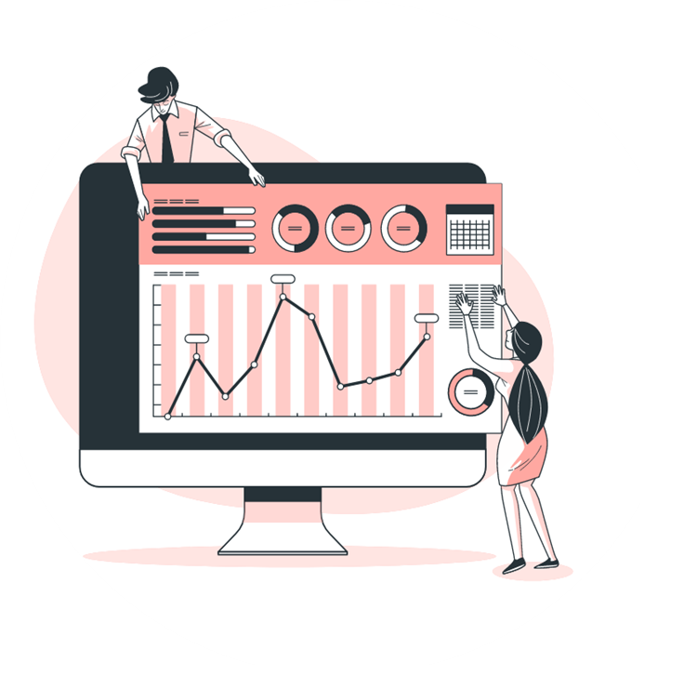
Approach in Achieving Project Goals
Plan
Allocate
Meet / Collaborate
Execute
Adjust
Finalize
We used the '.pct_change' module from the pandas library to create a dataframe of daily returns from each fund, and the '.describe' function to get basic summary statistics of the daily returns dataframe that we created.

Slide 11
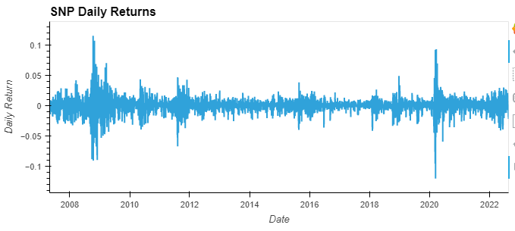
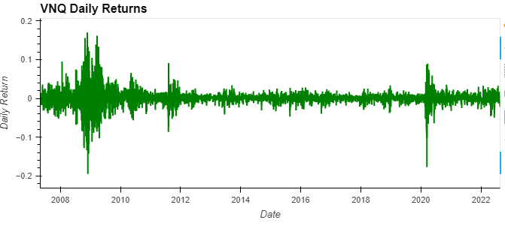
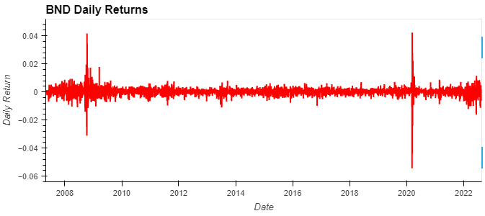
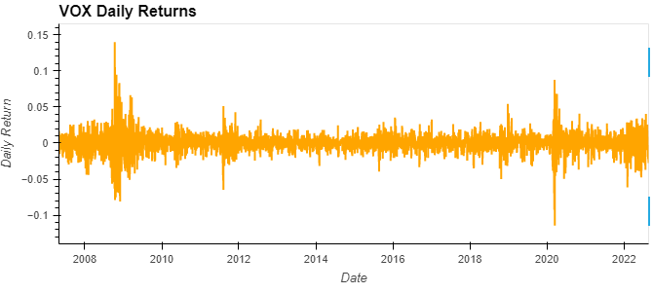
Approach in Achieving Project Goals
We used the display function along with the '.line' module from the hvplot library to visualize the daily returns of each fund.

Slide 12
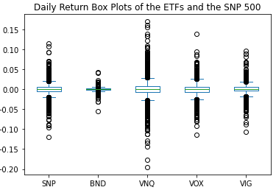
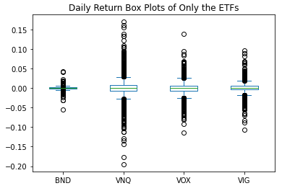
Approach in Achieving Project Goals
Plan
Allocate
Meet / Collaborate
Execute
Adjust
Finalize
We used the '.plot(kind=box)' module in pandas to display box plots of each of the funds.

Slide 13
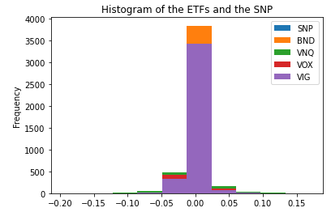
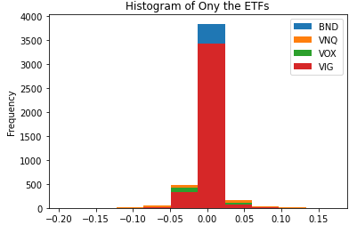
Approach in Achieving Project Goals
Plan
Allocate
Meet / Collaborate
Execute
Adjust
Finalize
We used the '.plot(kind="hist")' module in pandas to display a histogram of the funds.

Slide 14
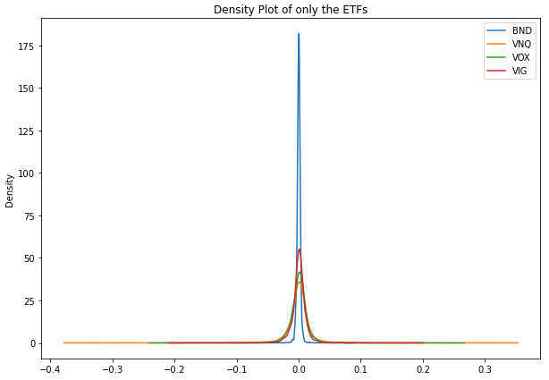
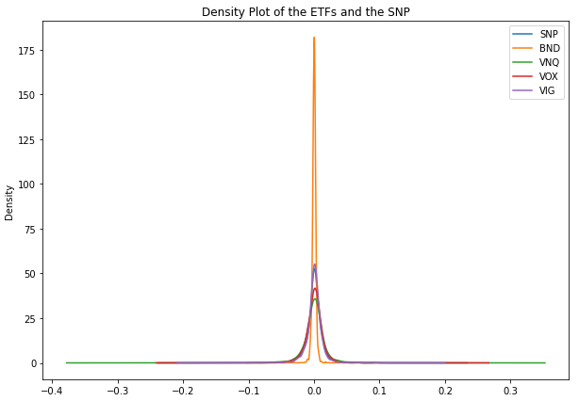
Approach in Achieving Project Goals
Plan
Allocate
Meet / Collaborate
Execute
Adjust
Finalize
We used the '.plot.density' module in pandas to display a density plot of the funds.

Slide 15
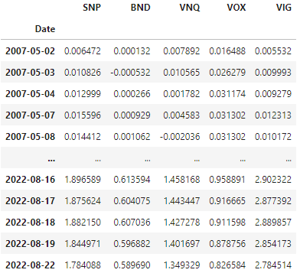
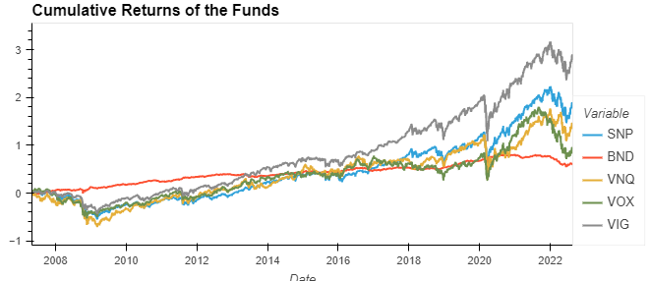
Approach in Achieving Project Goals
Plan
Allocate
Meet / Collaborate
Execute
Adjust
Finalize
We used the '.cumprod()' mmodule in pandas to calculate the cumulative returns, and the '.line' module from hvplot library to create a line plot to visualize the cumulative returns of the funds.

Slide 16



Approach in Achieving Project Goals
Plan
Allocate
Meet / Collaborate
Execute
Adjust
Finalize
We used the '.std()' module in the numpy library to calculate the standard deviations of the daily returns for each fund.
We used the '.sqrt()' module in the numpy library to calculate the annualized standard deviation.
We also used the '.mean()' module in the numpy library to calculate the annual average returns of each of the funds.
STD
Annualized STD
Annual Avg Returns

Slide 17
Approach in Achieving Project Goals
Plan
Allocate
Meet / Collaborate
Execute
Adjust
Finalize
We used the '.var()' module in the numpy library to calculate the variance of the SNP 500, which is what we will use for the standard variance in future calculations.
We also used the '.cov()' module in the numpy library to calculate the covariance of each fund based on the SNP 500.
We then used the prior calculations to calculate the beta of each fund based on the variance of the SNP 500.
Variance
Covariance
Beta

Slide 18
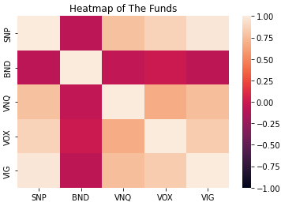
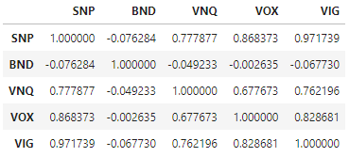

Approach in Achieving Project Goals
Plan
Allocate
Meet / Collaborate
Execute
Adjust
Finalize
We used the '.corr()' module from the pandas library that allows for us to calculate the correlation of each fund in a dataframe.
We then used the '.sum()' function to calculate the sum of the correlation values for each fund.
We also used the 'sns.heatmap()' module from the seaborn library to visualize the prior correlation calculations.
Correlation Dataframe
Sum of Corr Values

Slide 19
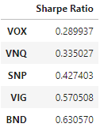
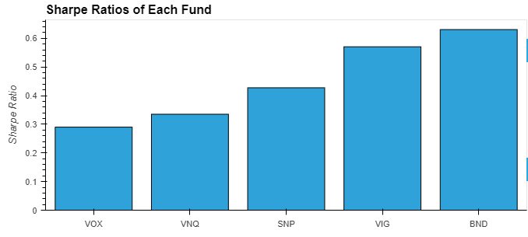
Approach in Achieving Project Goals
Plan
Allocate
Meet / Collaborate
Execute
Adjust
Finalize
We used prior calculations to calculate the sharpe ratios of each fund.
We then used the '.bar()' module in the hvplot library to visualize the previously calculated sharpe ratios.

Slide 20
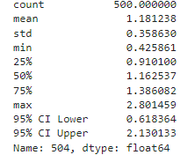
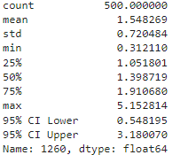
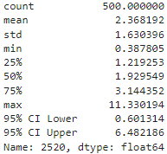
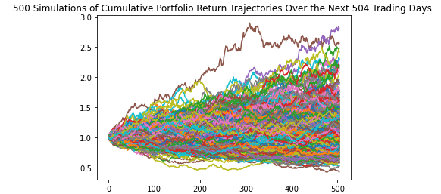
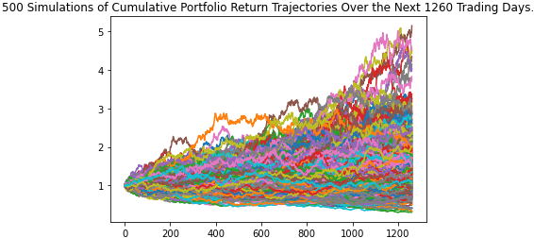
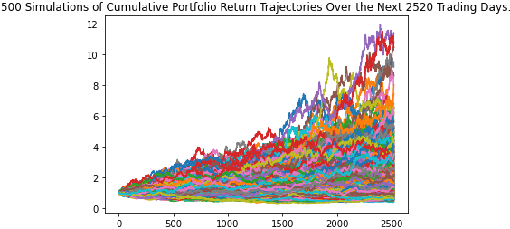
Approach in Achieving Project Goals
Plan
Allocate
Meet / Collaborate
Execute
Adjust
Finalize
We used the Monte Carlo simulation to predict the performance of the a fund in the short , average, and long term.

Slide 21
Approach in Achieving Project Goals
Plan
Allocate
Meet / Collaborate
Execute
Adjust
Finalize
We then created a dictionary that goes through the summary statistics of each fund and displays the mean/average return trajectories.
Short-term
Avg/Med-term
Long-Term

Slide 22
Approach in Achieving Project Goals
Plan
Allocate
Meet / Collaborate
Execute
Adjust
Finalize
Unanticipated insights or problems that we encountered and how those been resolved:
Monte Carlo simulations
The way that the MCForecastTools.py file is set up caused for some confusion when our dataframes did not work for a monte carlo analysis.
After numerous troubleshooting attempts and further inspection into the matter, we were able to configure the dataframes to work given the specifications of the tool file.

Slide 23
Next STEPS ……
05

Slide 24
Next STEPS ……
Expand to include different ETF products - strategies
Expand to include different type of securities - stocks, bonds, derivatives, digital assets, etc
Financial application to combine different type of securities to get optimal returns

Slide 25
THANK YOU
Do you have any questions?
You can access our repository at
https://github.com/AdamCooke22/project_one.git

